Slide 1
Honeynets in Maritime Cybersecurity:
From Concept to Implementation
Based on:
Paper 1 (The Foundation): A Ship Honeynet to Gather Cyber Threat Intelligence for the Maritime Sector https://ieeexplore.ieee.org/10223347
Paper 2 (The Extension) : HoneyShip: Unveiling Cyber Threats to Maritime VSAT Systems with a High-Interaction Honeypot https://ieeexplore.ieee.org/11087909
Anurudh Singh
Old Dominion University
Electrical and Computer Engineering Department
Date: March 30, 2026
Assignment 5: Literature Review(CS800)
LinkedIn: https://www.linkedin.com/in/singh-anurudh/

Slide 2
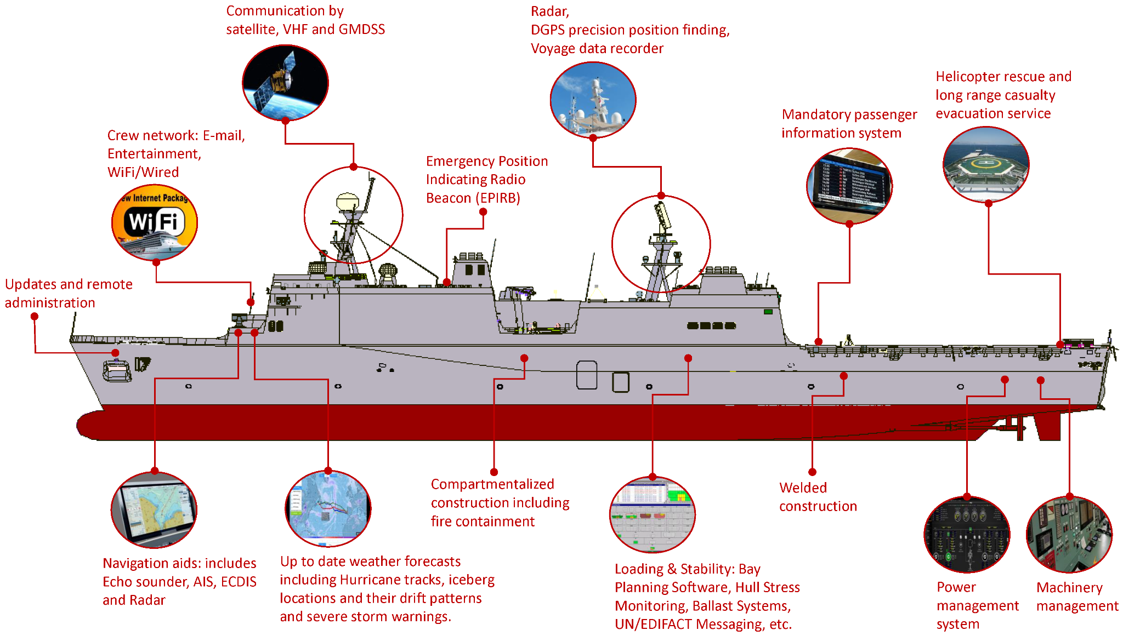
Automation Systems for Modern and Autonomous Ships

Slide 3
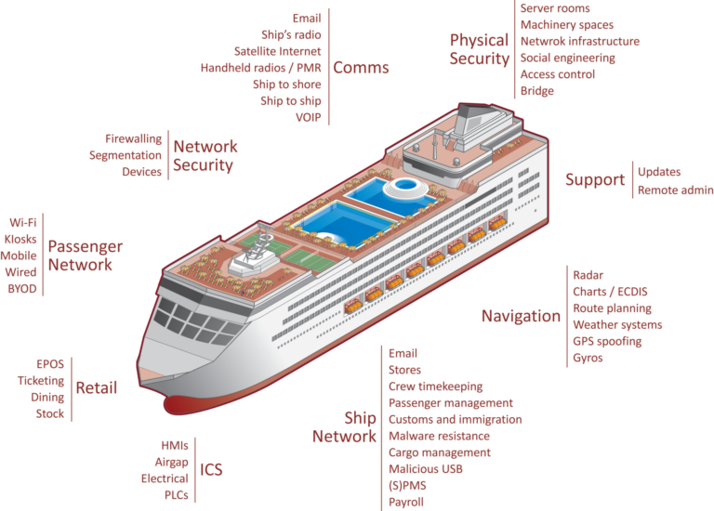
The Core problem: The Silent Maritime Threat
The Vulnerable Maritime Backbone
$7 Trillion: Value moved by Global Maritime Transportation System (GMTS).
The Conflict: Highly critical, yet technologically fragile.
Aging Fleets: Legacy operational technology (OT) is now online.
Low Maturity: Cyber security awareness in the sector is historically low.
The Result: Increasing, unreported, and misunderstood attacks.

Slide 4
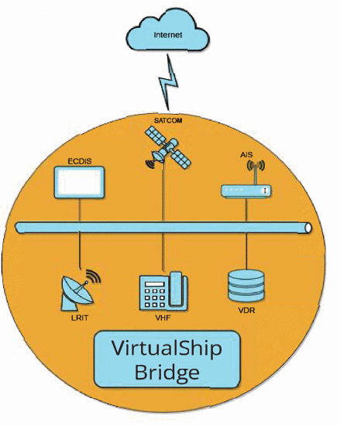
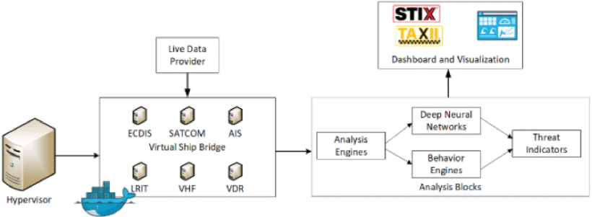
Paper 1 - The Architect’s View
Paper: A Ship Honeynet to Gather Cyber Threat Intelligence for the Maritime Sector (2023)
The Concept: Creating a comprehensive "Ship Honeynet" to protect the GMTS.
The Environment: Modern ships operate as "floating cities" (convergence of IT and Operational Technology).
The Goal: Generate actionable Cyber Threat Intelligence (CTI) using standardized frameworks (STIX/TAXII).
Figure: Minimal architectural drawing of the ship Honeynet
Figure: Five Block ship Honeynet architecture based on “System Design Architecture”

Slide 5
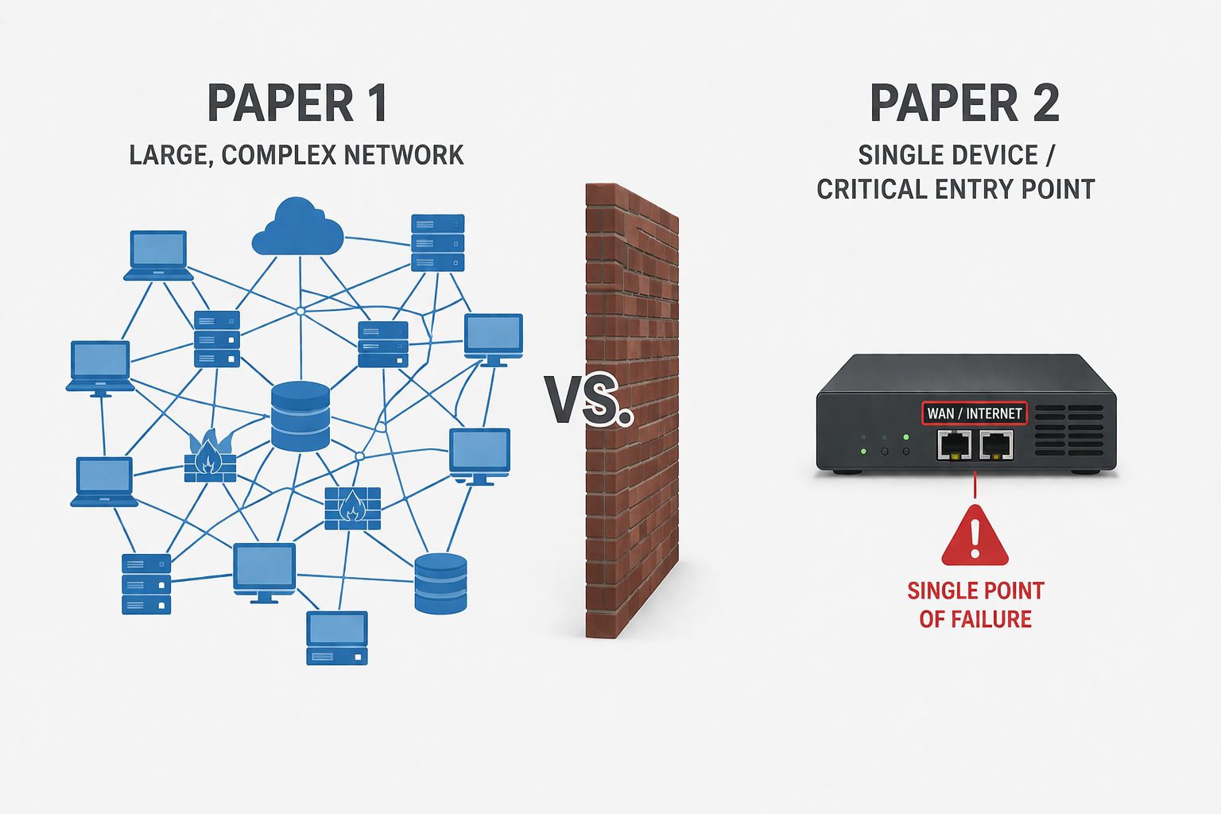
Transition: The Implementation Gap
The Limitation: Total-ship emulation is highly complex, resource-intensive, and difficult to deploy at scale.
The Shift: Moving from internal network complexity to edge-network vulnerability.
The Critical Node: Satellite communications (VSAT) represent the most exposed entry point for external attackers.
The Need: A focused, practical implementation targeting the most exposed maritime interface.
Figure: Comparison of network security architectures: a large-scale, distributed network (Paper 1) versus a single-device, critical entry point design (Paper 2).

Slide 6
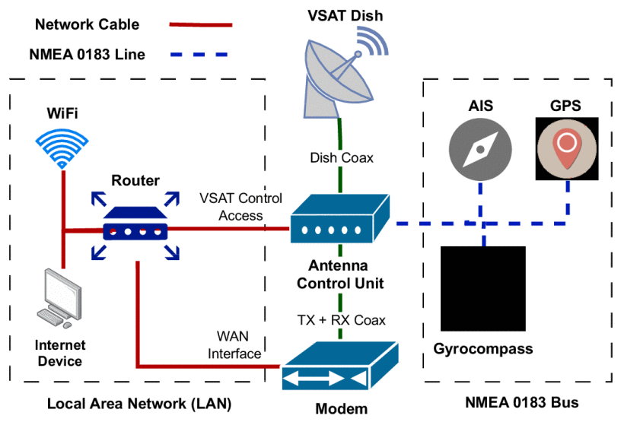
Paper 2 - The Specialist’s Execution
Paper: HoneyShip: Unveiling Cyber Threats to Maritime VSAT Systems with a High-Interaction Honeypot (2025).
The Solution: Design, deploy, and analyze data from a specialized, high-interaction honeypot simulating a VSAT system.
Methodology: Reconnaissance via Shodan to identify real-world VSAT vulnerabilities.
Verification via Nmap.
Deployment of an indistinguishable decoy.
Results: Logged thousands of interactions; identified automated probing and maritime-specific threat patterns.
Fig. A simplified overview of a ship's network, where the VSAT provides internet access to a LAN while being connected to an NMEA bus.

Slide 7
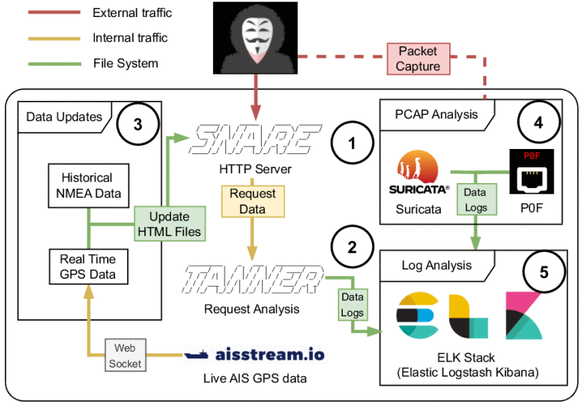
Paper 2 - HoneyShip Architecture
HTTP server entry point
Real-time data simulation
Traffic monitoring
Log analysis (ELK stack)
Fig.The Architecture of the HoneyShip honeypot, showing the components to provide the VSAT interface, the updating of the honeypot interface, capturing and analyzing network traffic, and the ELK stack for real-time monitoring and analysis.

Slide 8
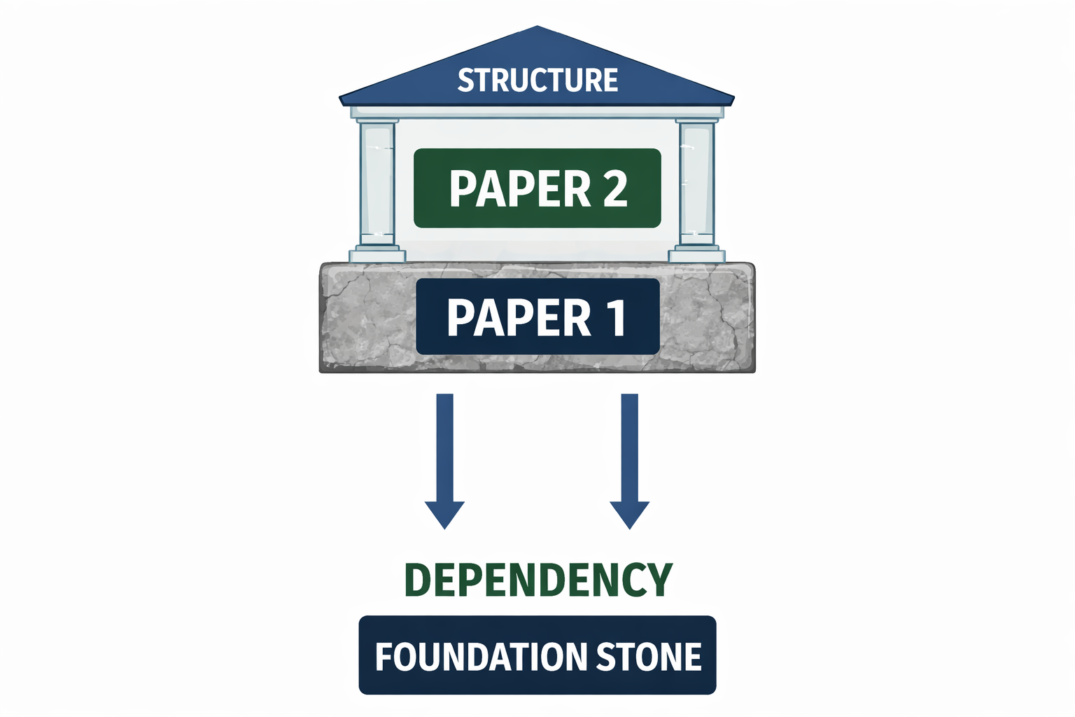
The Relationship: Why it cites Paper 1
The Substantive Link: Paper 2 utilizes Paper 1’s definition of the maritime CTI deficit as its primary justification.
Evolution of Thought: From macro-architecture (identifying the need) to micro-implementation (gathering the data).
The Build: HoneyShip solves the scalability and complexity issues of the "Ship Honeynet" by isolating the most critical attack vector.
Fig. Paper 1 as the foundational layer enabling and supporting the structure developed in Paper 2

Slide 9
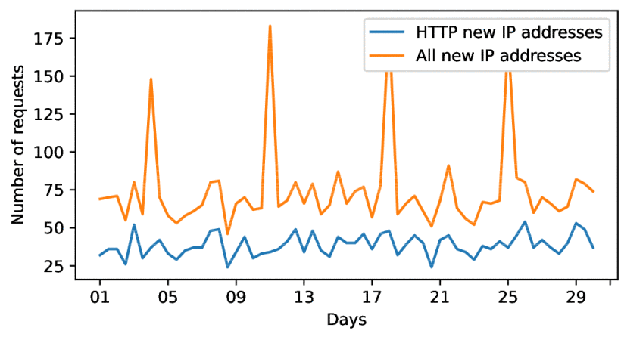
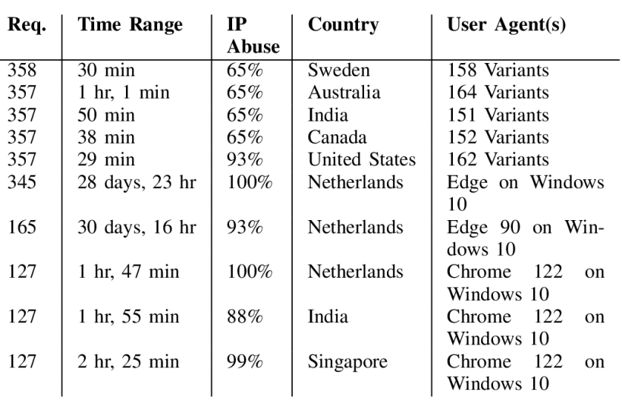
HoneyShip Methodology & Findings
Focused Attack Vector: VSAT (Very Small Aperture Terminal) Systems. The satellite uplink.
High Interaction Deception: Not just simulating an open port, but an interactive OS/stack.
Methodology: Used Shodan to fingerprint real-world, vulnerable VSAT systems, then verified signature/uptime with Nmap.
Fig. The amount of previously unseen IP addresses of requests to the honeypot every 12 hours over one month
Key Findings:
Thousands of unique IP interactions in one month.
Most attacks are automated, probing known vulnerabilities.
Identified "Previously Unreported Patterns" of attack specifically targeting maritime protocols.
Table. The top 10 most active clients identified by ip address, ordered by the amount of http requests

Slide 10
Synthesis & Conclusion
The Roadmap: Effective maritime defense requires bridging comprehensive theory with targeted execution.
The Future: Aggregating data from specialized decoys (HoneyShip) to fulfill the original vision of sector-wide intelligence (Ship Honeynet).
39,000+ interactions
2,600+ unique IPs
Mostly automated attacks
Known vulnerabilities exploited
Synthesis: These papers demonstrate the maturation of a niche field.
Phase 1 (Vavra et al. 2023): Vision and comprehensive framework (Theoretical Top-Down).
Phase 2 (HoneyShip 2025): Targeted execution and real-world data gathering (Practical Bottom-Up).
Takeaway: Efficient maritime security requires starting with focused, high-interaction deception (like HoneyShip) before scaling to total-ship integration (like the Ship Honeynet).

